Slide 1
Earthquake Update - Group 1
Varun, Yixin, Nathan

Slide 2
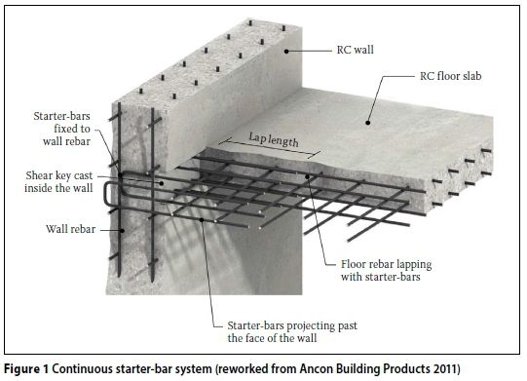
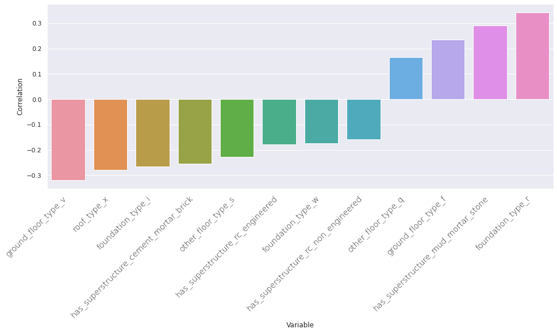
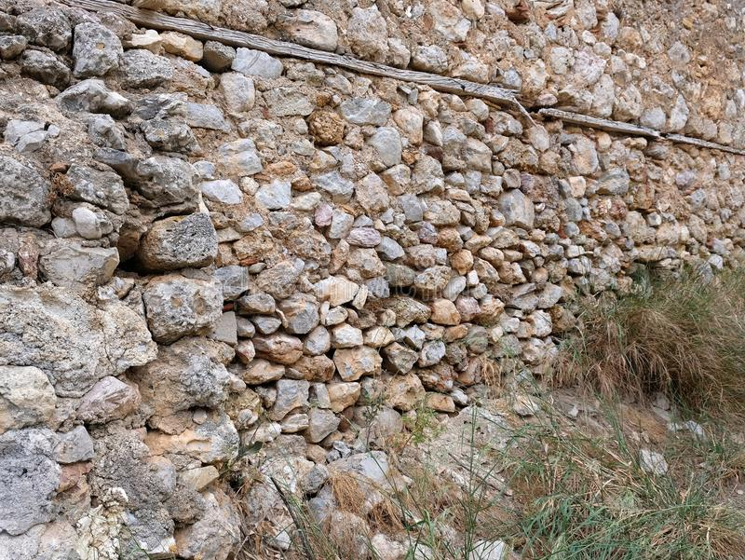
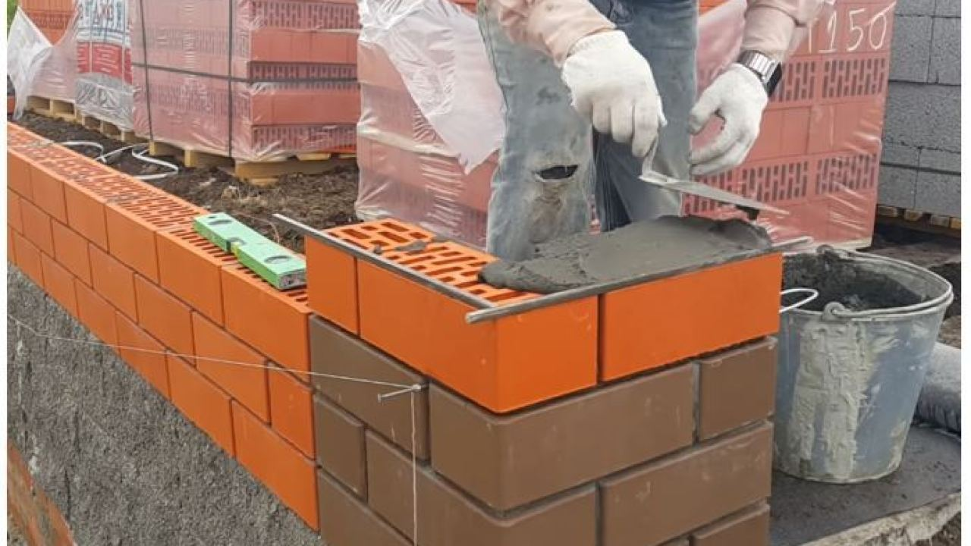
More EDA, correlations are somewhat as expected
Notes:
Correlations, talk about how height_percentage may be surprising

Slide 3
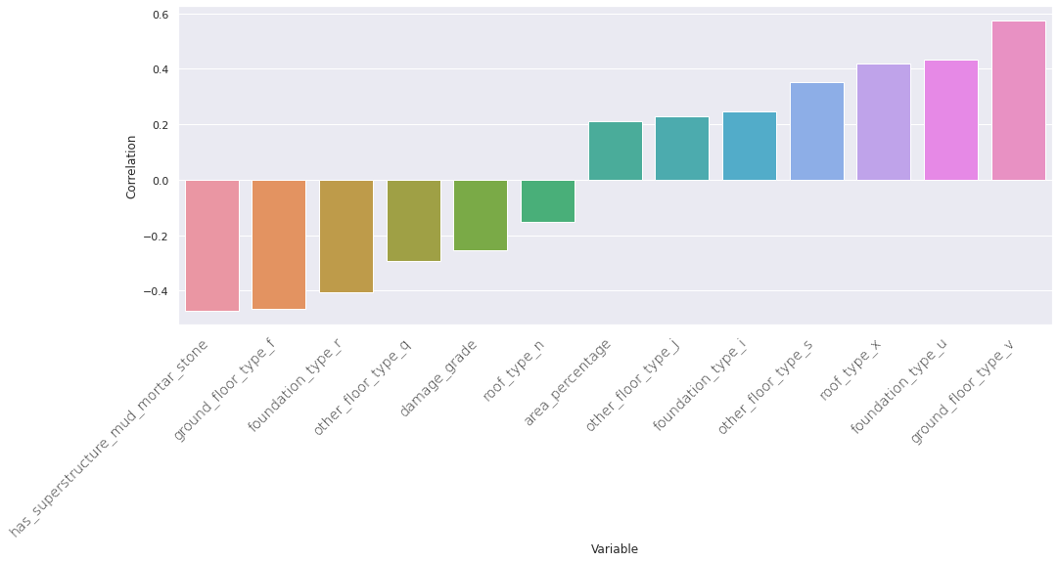
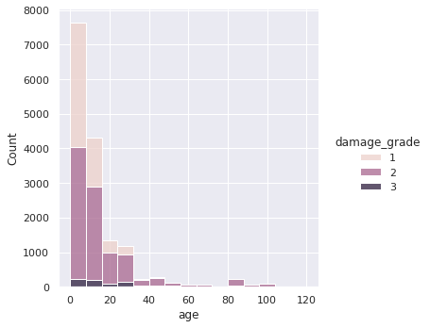
Cement mortar and brick buildings are very new
Buildings made with cement mortar and brick use certain floor_types, roof_types, etc.
Mean age for all buildings is 26, median 15. Mean for cement and mortar 12 with median 10 years.
Notes:
Tall buildings made with better superstructures, often newer buildings as well

Slide 4
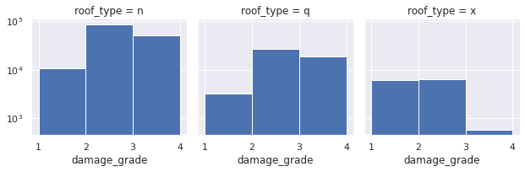
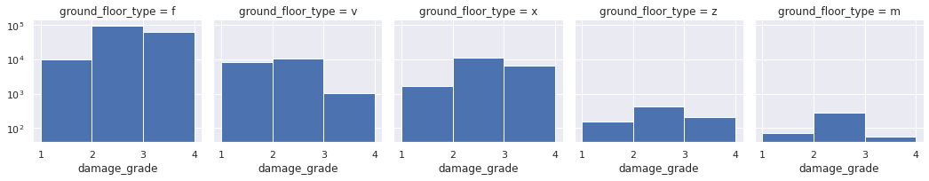
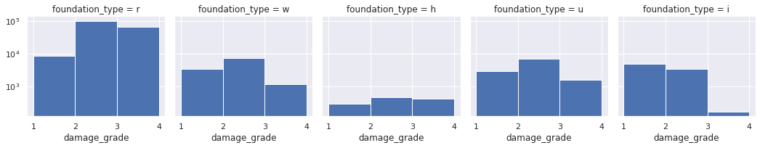
roof_type x, ground_floor_type v, and foundation_type i/u preferred by builders of cement mortar and brick buildings
Notes:
The building materials that are common in tall buildings tend to sustain less damage.

Slide 5
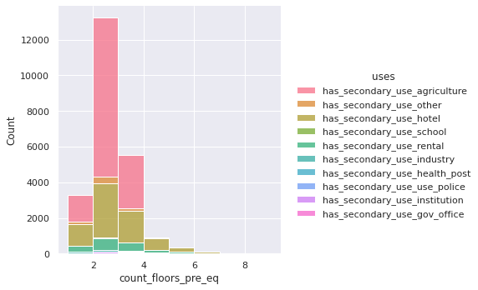
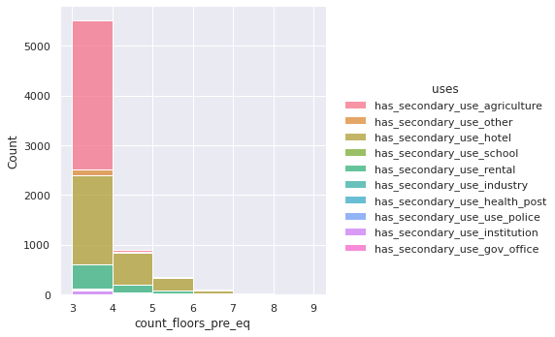
Nepali economy dominated by agriculture and tourism

Slide 6
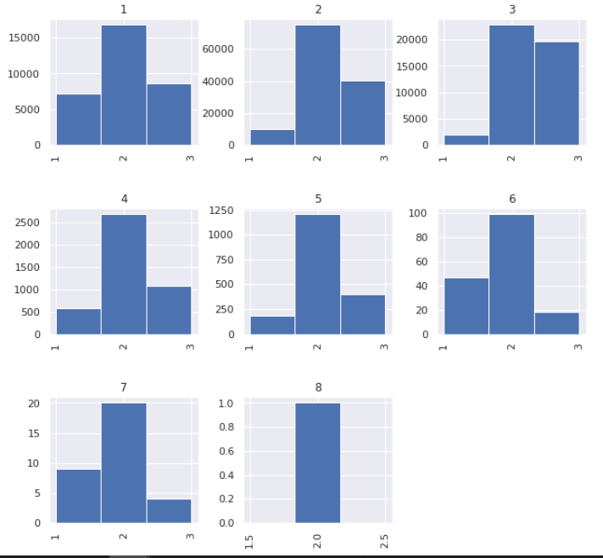
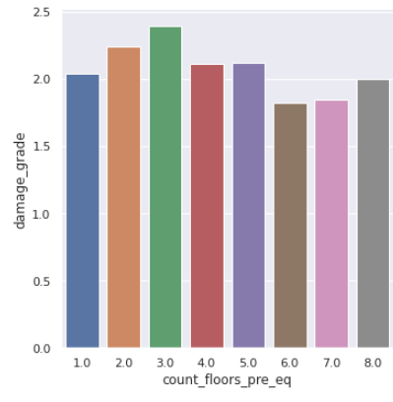
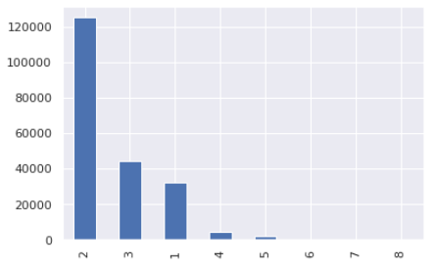
count_floors_pre_eq
damage_grade ~ count_floors_pre_eq
mean(damage_grade) ~count_floors_pre_eq
dist(count_floors_pre_eq)

Slide 7
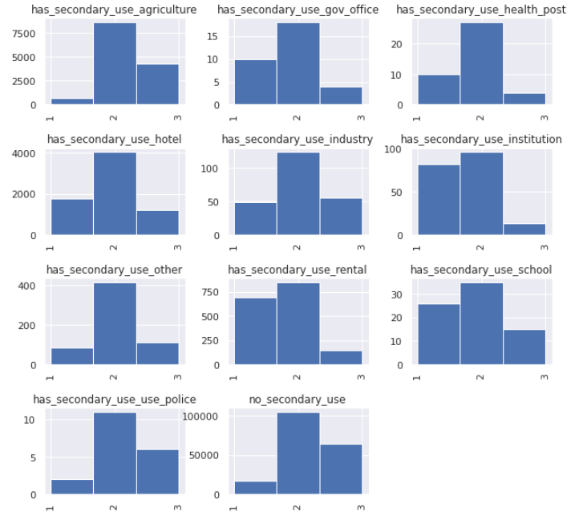
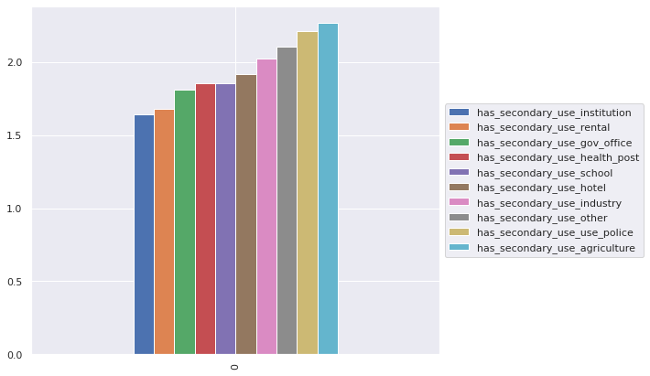
Secondary use
damage_grade ~ secondary use
mean(damage_grade) ~secondary_use
(mean)Institution: lowest; agriculture: highest

Slide 8
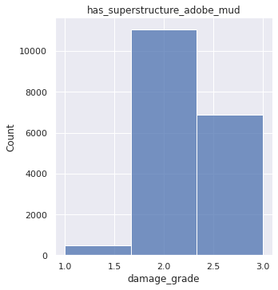
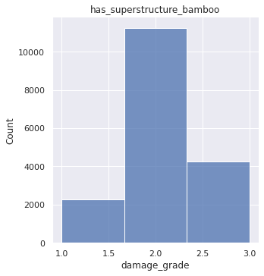
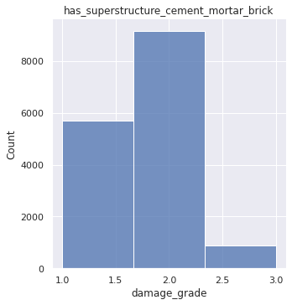
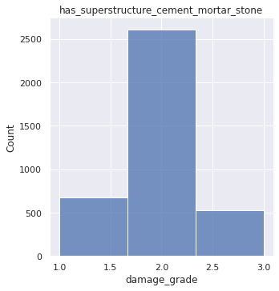
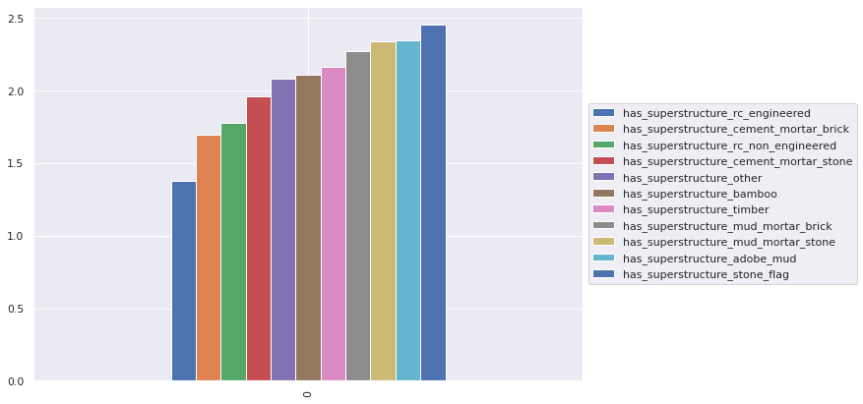
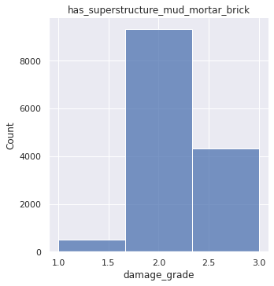
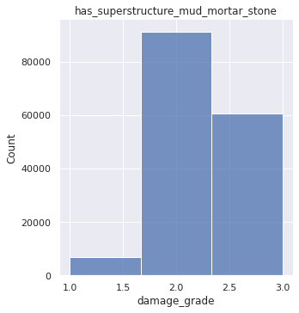
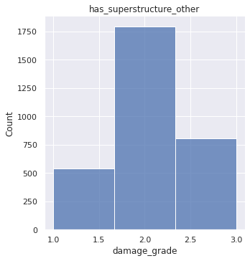
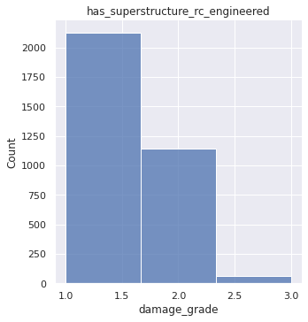
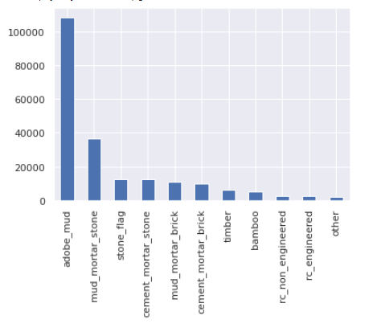
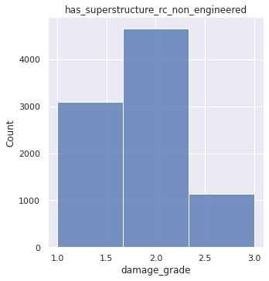
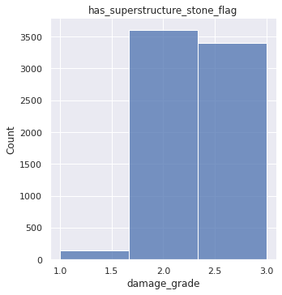
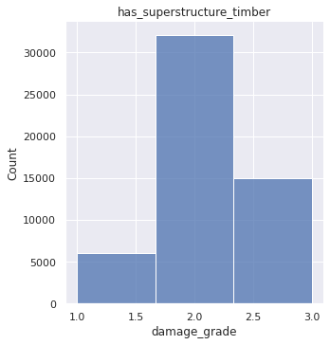
Has superstructure
damage_grade ~ superstructure
damage_grade ~superstructure
rc_engineered
stone_flag
(dist) adobe mud: largest

Slide 9
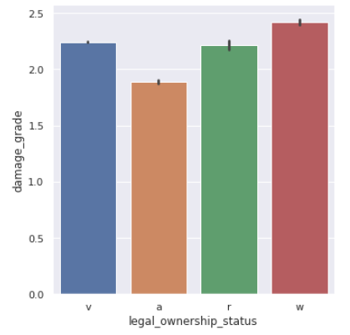
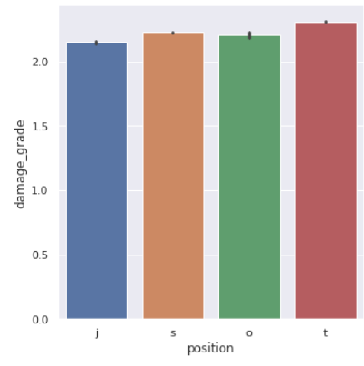
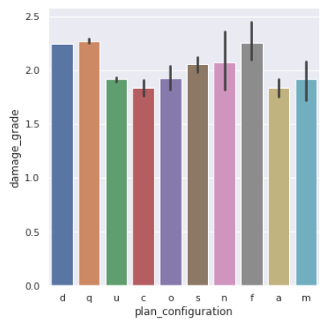
damage_grade ~ legal_ownership_status
damage_grade ~ position
damage_grade ~ plan configuration

